Slide 1
Boosting Algorithm

Slide 2
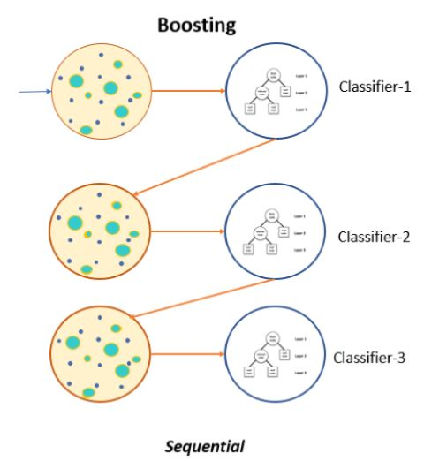
What is Boosting?
Its combine set of weak learners convert into a strong learners.
Minimize the training errors.
It will Improve the prdiction accuracy.
Notes:
k

Slide 3
Types of Boosting Algorithm
Ada boost
XG boost
LG boost

Slide 4
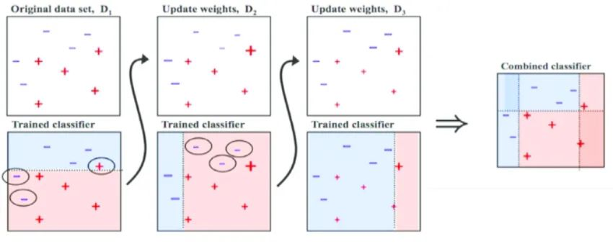
Adaptive boosting or AdaBoost
It working same as normal boosting algorithm.
Identify the misclassified datapoints &adjusting their weights to minimize the training error.
This model continues optimize in sequentially until it wil get the strongest predictor.

Slide 5
Ada Boost
Disadvantages:
Advantages:
Advantages:
It increases the accuracy of weak learning models.
ability to combines multiple weak learners to form a strong learners.
USES:
Its used for both classificaation and regression.
adaboost needs the quality data for training as it is very sensitive to noisy data and outliers.

Slide 6
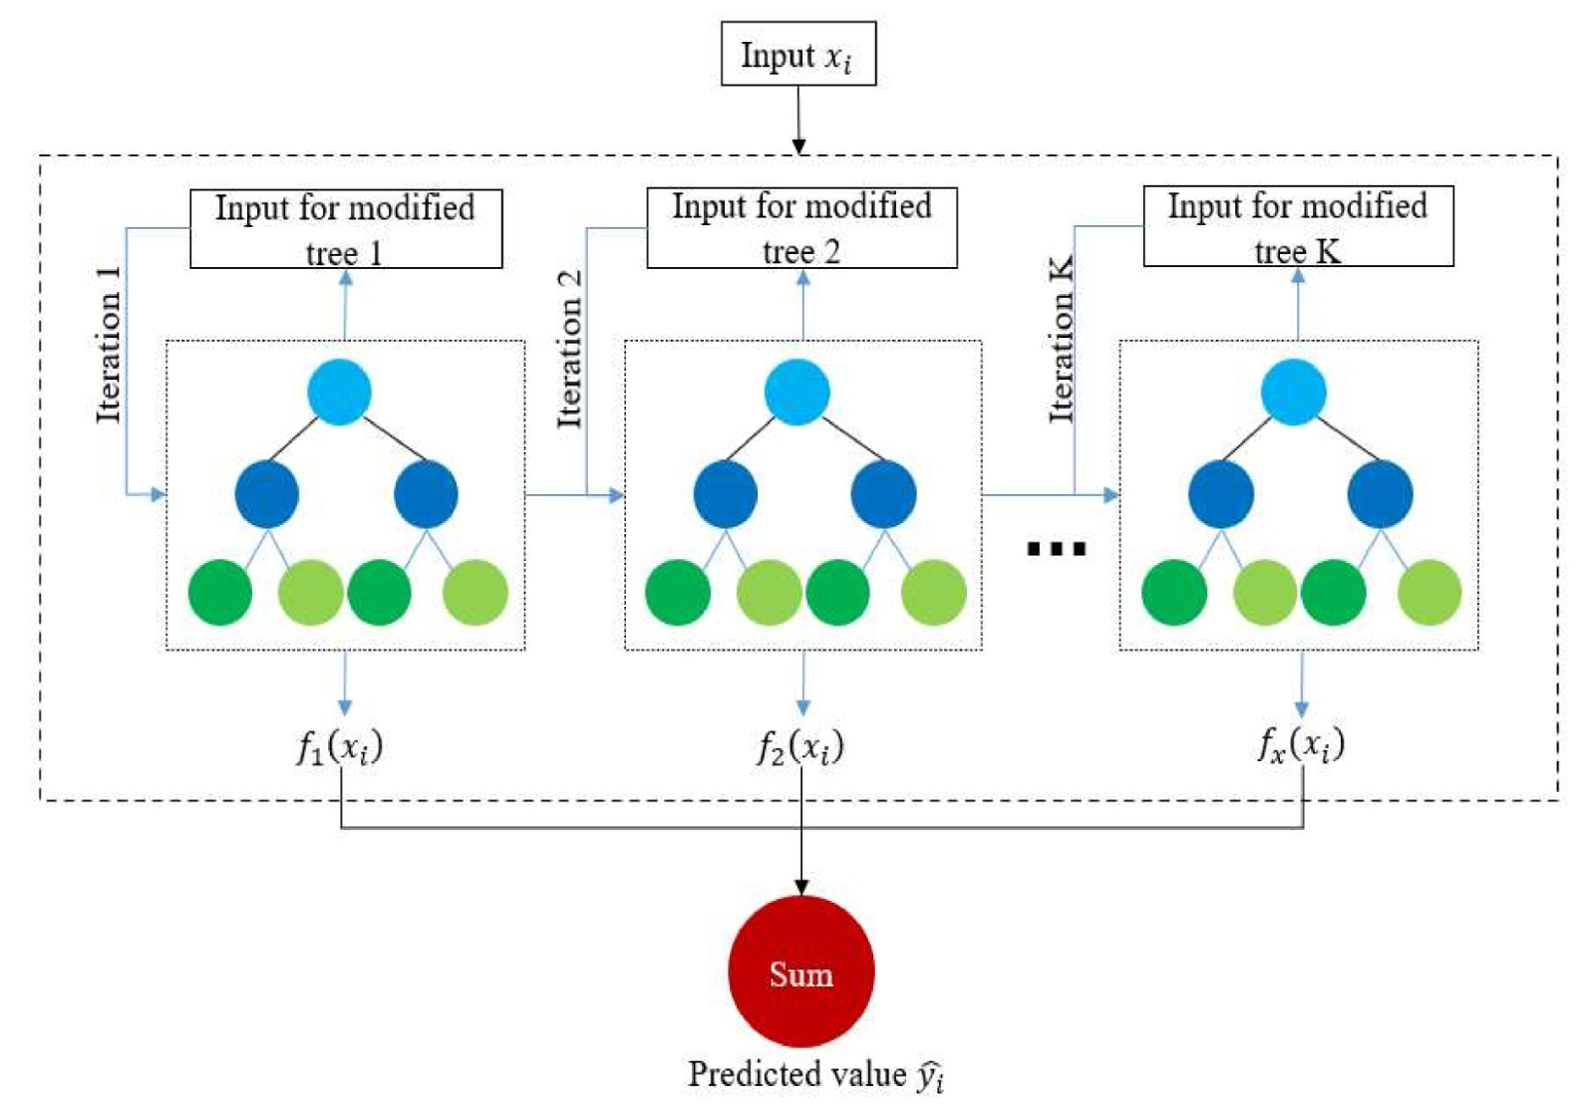
Extreme gradient boosting or XGBoost
It has additional funtionality.
Distributed machine learning process.
More computational speed and model efficiency.

Slide 7
XGBoost
Advantages:
Disadvantages:
Performance : It will give high-quality results.
Scalabilty: suitable for large dataset.
Customizability: hyperparameters can be adjusted to optimize performance making it highly customizable.
Interpretability: better understanding of which variables are most important in making predictions.
It is a complex algorithm and can be difficult to interpret.
It is slow to train due to its many hyperparametrs.
It can be prone to overfitting if not properly tuned.
Its memory intensive and is not suitable for low end systems.
Uses:
it is widely used to estimate housing price and sales When the objective variable reflects a continous output.

Slide 8
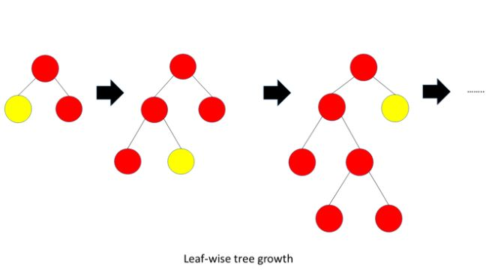
LG Boosting
Leaf wise tree growth
Strong learners given the better accuracy.

Slide 9
LG Boosting
Advantages:
Disadvantages:
Faster Speed and Higher Accuracy
Lower Memory Usage
Better Accuracy
Capability to Handle Large-Scale Data
Uses:
Large dataset
Overfitting
It is completly avoid weak learners.

